Slide 1

Python project 1:
Testbench Generator individual enhancement stage
Professor: Carolina Rosas Huerta
Student: David Xchel Morales Hurtado

Slide 2

Top model code translator

Slide 3

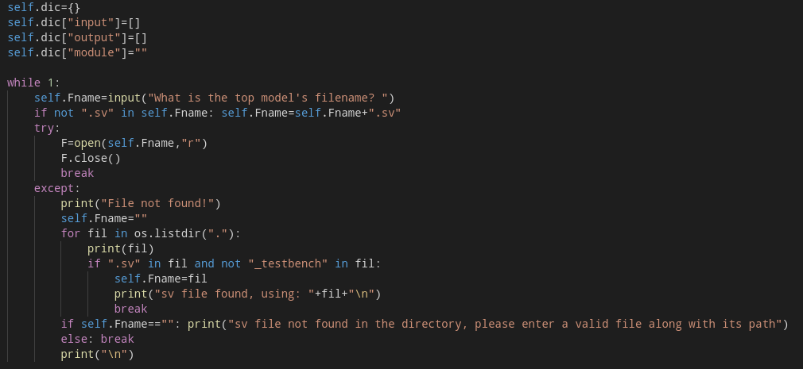
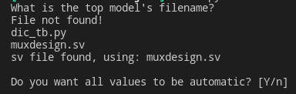
Load function
Output:
Exception handling
Automaticaly chooses file in the directory
Can be called outside the constructor
Initializes the dictionary

Slide 4
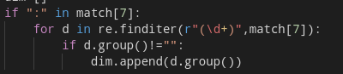
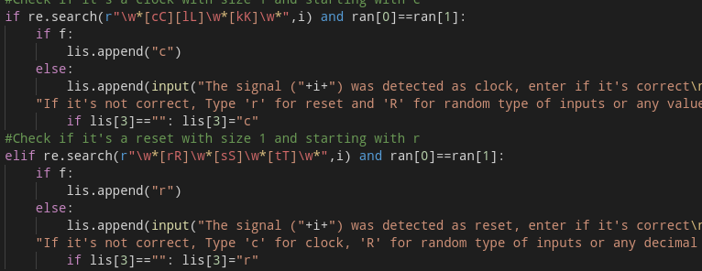
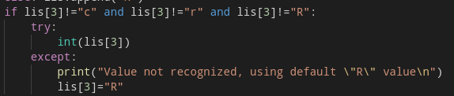
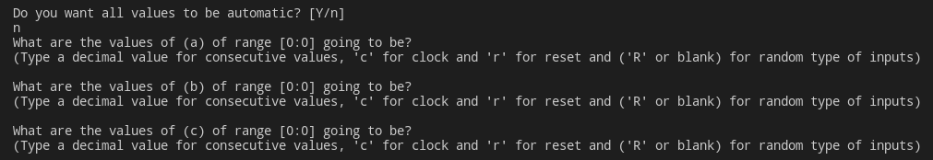
Translator function
Dimension saving for input and output
for its writing and inout values in case
it’s needed
When in manual translation, checks
with the user if the detected clock
and reset signals are correct and can
be changed by the user if not
Detects if a value is erroneus and
changes it to a default random value
even when entering blank answers
Output:

Slide 5
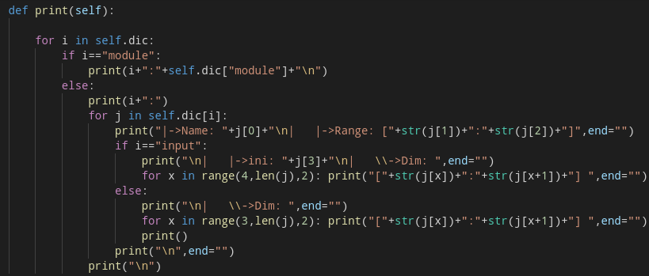
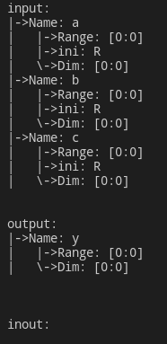
Print function
Output:
New print function for better understanding of the contents of the dictionary stored in the Translator object printing even multiple dimension signals

Slide 6
Testbench writing code

Slide 7
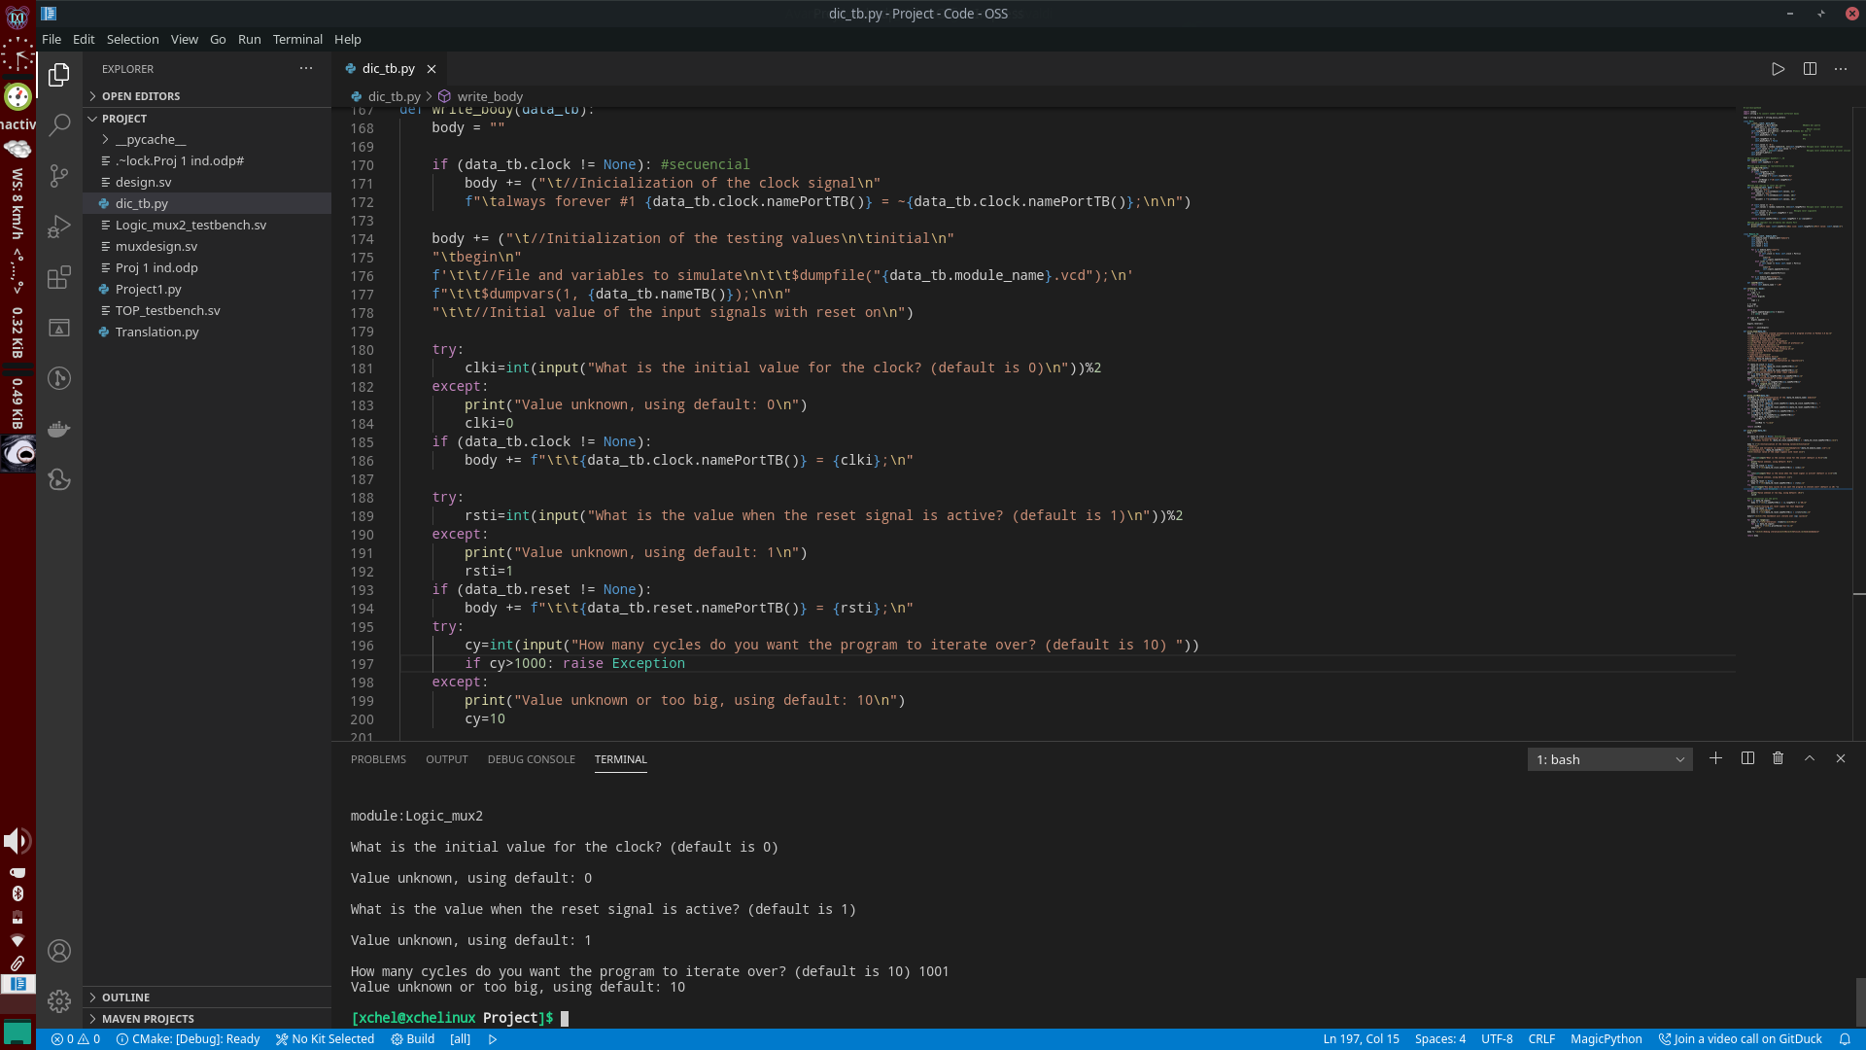
Write_body function
Checking of clock and reset initial value
with the user using default values
Asking how many iterations the user wants with a default of 10 in case the value isn’t an integer or it’s too big
(as a failsafe in case of simulating)
Detects if a value is erroneus and
changes it to a default random value
even when entering blank answers
Output:

Slide 8
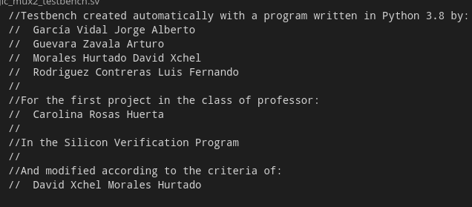
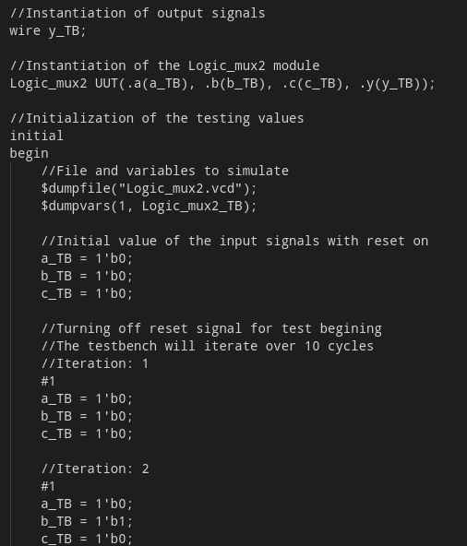
General testbench format
More information about the file created in the header
More information about the lines in the file
Information about the number of iterations in the testbench and the iteration that is been printed.

